Slide 1
AirbnbListings
View in Power BI
Last data refresh:
11/05/2025 16:07:39 UTC
Downloaded at:
15/05/2025 10:14:50 UTC

Slide 2
Listing Overview
Notes:
Top 7 Expensive Listings and their Review Scores
No alt text provided
No. of Listings per City
No alt text provided
card
No alt text provided
5 Most Listed Property Types
No alt text provided
Most Expensive Neighborhoods
No alt text provided
Filter by City
No alt text provided
Most Expensive Property Types
No alt text provided
Hosts with the most Listings
No alt text provided
actionButton
No alt text provided
shape
No alt text provided
shape
No alt text provided
shape
No alt text provided
shape
No alt text provided
shape
No alt text provided
textbox
No alt text provided

Slide 3
Location Quality
Notes:
textbox
No alt text provided
actionButton
No alt text provided
Avg Review Scores per City
No alt text provided
No. of Airbnb Neighborhoods
No alt text provided
Percentage of 5 star listings per city
No alt text provided
Correlation between No. of reviews and score
No alt text provided
textbox
No alt text provided
image
No alt text provided
textbox
No alt text provided
lineClusteredColumnComboChart
No alt text provided
image
No alt text provided
actionButton
No alt text provided
shape
No alt text provided
shape
No alt text provided
shape
No alt text provided
shape
No alt text provided

Slide 4
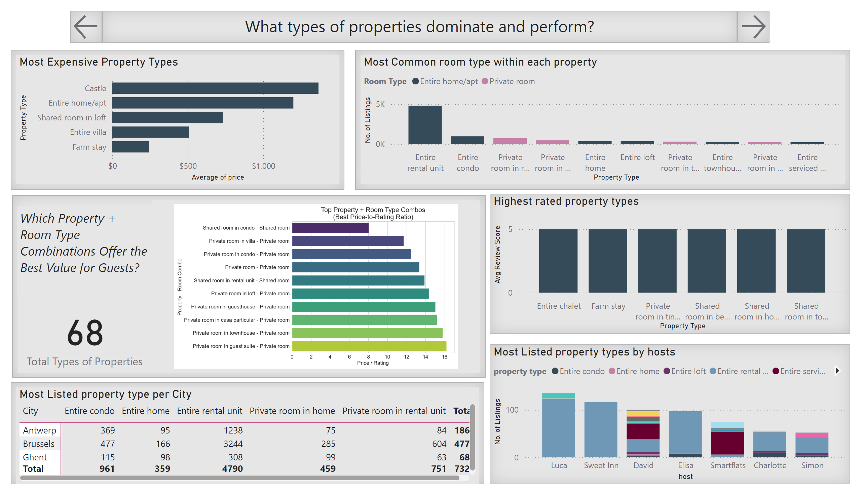
Property Type Performance
Notes:
actionButton
No alt text provided
textbox
No alt text provided
Most Expensive Property Types
No alt text provided
Highest rated property types
No alt text provided
Most Common room type within each property
No alt text provided
Most Listed property type per City
No alt text provided
Most Listed property types by hosts
No alt text provided
pythonVisual
No alt text provided
card
No alt text provided
textbox
No alt text provided
actionButton
No alt text provided
shape
No alt text provided
shape
No alt text provided
shape
No alt text provided
shape
No alt text provided

Slide 5
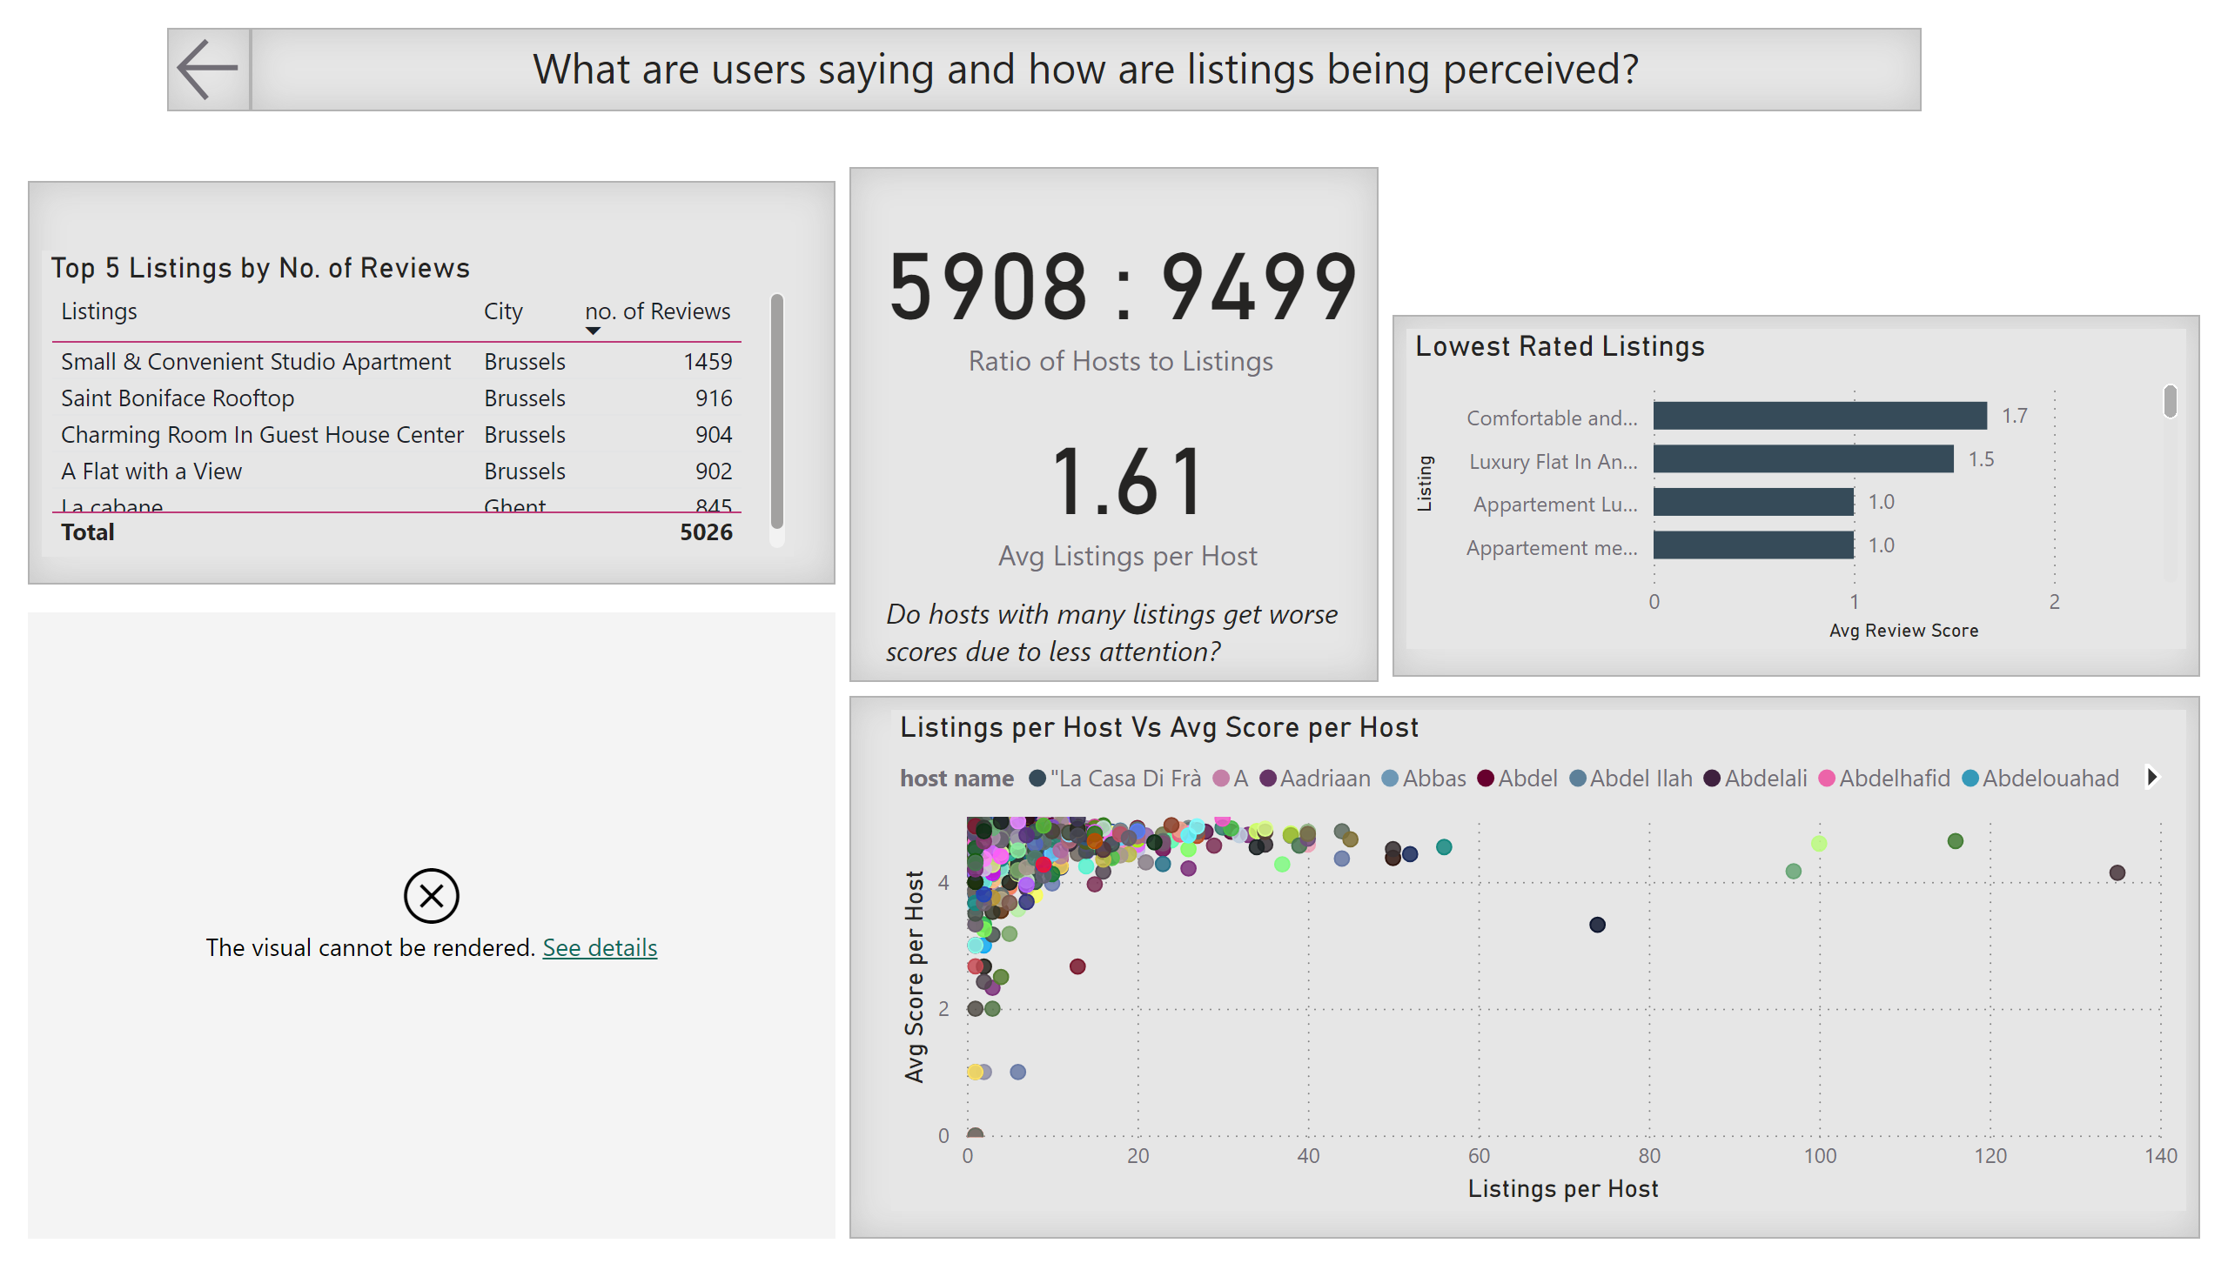
Listing Perception
Notes:
Lowest Rated Listings
No alt text provided
Top 5 Listings by No. of Reviews
No alt text provided
pythonVisual
No alt text provided
card
No alt text provided
card
No alt text provided
Listings per Host Vs Avg Score per Host
No alt text provided
textbox
No alt text provided
textbox
No alt text provided
actionButton
No alt text provided
shape
No alt text provided
shape
No alt text provided
shape
No alt text provided
shape
No alt text provided

